Slide 1

Milestone 2: Testing
Software Engineering
for AI Enabled Systems
Students: Basile Andrea, Iacovazzi Antonio Raffaele, Lorusso Roberto

Slide 2
Testing Data
In a ML model data are the most critical aspect, as the motto says "trash in - trash out" so we need to carefully check if data are coherent with a set of predefined quality check and avoid that strange values could spoil the training phase and the overall model's quality.
Especially in dataset that grow over time, for example collecting users data, this step is crucial since there are chance that users could send non reliable data.

Slide 3

Great Expectations
A tool that can help us to do this kind of tests is Great Expectations.
It offers a set of functionality that helps developers to build up reliable tests on datasets.
Great Expectations is oriented to tabular data and not images like in our project, but this has not been a problem, we have extracted a set of information from our dataset and saved them into a .csv file generated before applying the GE test suite.

Slide 4
Great Expectations: Feature Extraction
The information extracted are the followings:
File Name
File Type
Label
Colors (Y/N)
Height
Width
Variance of the Laplacian Filter

Slide 5

Great Expectations: Setting Up
The GE suite has been created importing the GE library and running the following commands:
that, in order:
create the whole infrastructure
link GE to the file that we want to check
create the test suite
create the checkpoint that is the mechanism that allows to run the tests

Slide 6
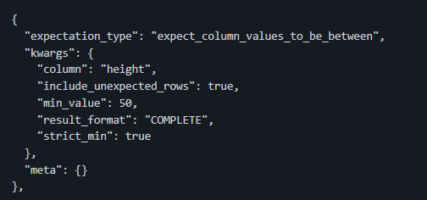
Great Expectations: A Sample Of Test
The test suite is a json file presents in great_expectations\expectations\img_features_suite.json were it's possible to express the kind of test, the checked column and the acceptable values for that column, for example:
This test checks that the column heigh has value greater than 50, this in order to avoid to train our model on really small images that have too less details and became noisy when scaled up.

Slide 7
Great Expectations: The Test Suite
The whole test suite include the followings tests:
Check on the label name: we want to avoid label that are not coherent with our purposes
Check on the color type: we want to allow or deny the possibility to add greyscale images
Check on the variance of the Laplacian filter greater than 0: if the Laplacian variance is 0 the image is monochromatic and then non informative, we want to block this kind of data
Checks on the heigh greater than 50: in order to avoid pictures that are too small
Checks on the width greater than 50: in order to avoid pictures that are too small
All the execution are stored into:
great_expectations\results\validations
and is possible to see the results through a GUI using the html page stored in:
great_expectations\results\data_docs\local_site\index.html

Slide 8

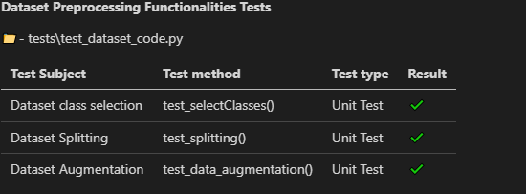
Testing Code with Pytest
In order to verify that the code perform its task in a correct way we need a mechanism that run the code in a close context and make assertion about the correctness of the results.
These mechanisms are the Unit Test and the Integration Test, the first type check the correctness of a function or a method, the second check the correctness of a whole sequence of modules.
In our project Pytest has been used in order to implement this kind of test and we have checked the correctness of the following modules:

Slide 9
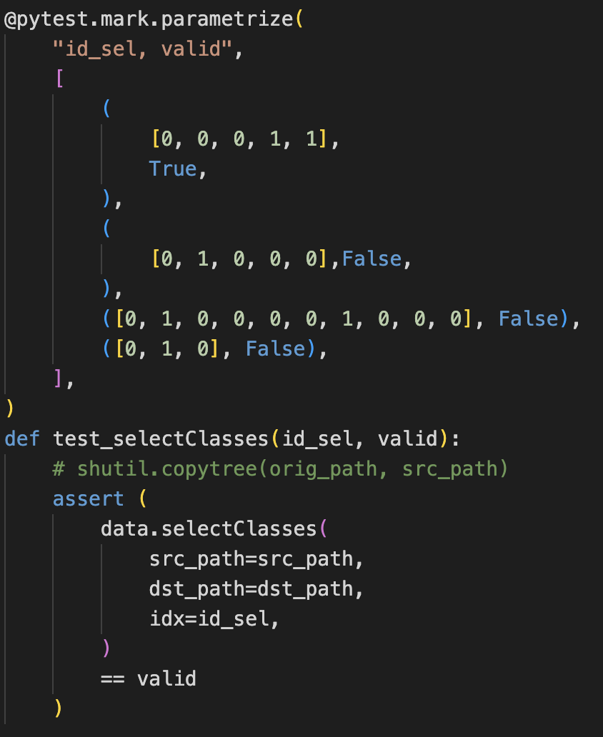
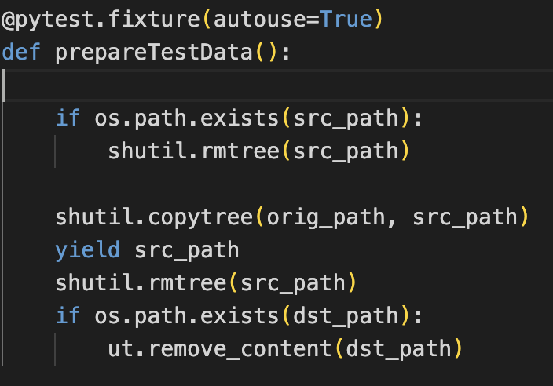
Testing Code -Description
test_selectClasses(): this unit-test verify that the method selectClasses() of dataset will correctly create the folder which contain only sub-folders corresponding to classes that we choose through an array.
We parametrize the test in order to:
Automate the input feeding using the @pytest.mark.parametrize
Create and removing the testing data

Slide 10
Testing Code -Description
test_splitting(): this unit-test verify that the method split_dataset() is executed correctly (returning True) then it assure that test, train and val path have been created.
An assertion is made in order to check that each folder of test set has same number of files.
Another assertion checks that train, test and validation set have same number of folders.
def test_splitting(): n_instances = 1
assert data.split_dataset(
src_path=src_path, dst_path=dst_path, n_instances=n_instances
)
assert os.path.exists(src_path)
assert os.path.exists(os.path.join(dst_path, "test"))
assert os.path.exists(os.path.join(dst_path, "train"))
assert os.path.exists(os.path.join(dst_path, "val"))
counter_test = ut.count_files(os.path.join(dst_path, "test"))
for number in counter_test:
assert number == n_instances
counter_train = ut.count_files(os.path.join(dst_path, "train"))
counter_val = ut.count_files(os.path.join(dst_path, "val"))
assert len(counter_test) == len(counter_train) == len(counter_val)

Slide 11
Testing Code -Description
test_data_augmentation(): is an unit-test that start the augment_data() method in order to reproduce new data and balance the dataset for each folder in the input path. The result of this method will be a dataset in which each folder has the same number of files. With this test we want to check that this goal is achieved.
def test_data_augmentation():
data.augment_data(src_path)
counter = []
counter = ut.count_files(src_path)
print(counter)
for number in counter:
assert number == counter[0]

Slide 12
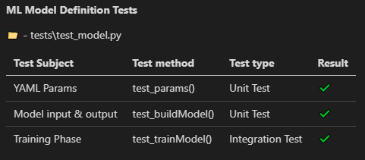
Testing Model Code -Description
In this phase of testing we are checking that our model is built correctly.

Slide 13
Testing Model Code -Description
def test_params():
assert os.path.exists("params.yaml")
with open("params.yaml", "rb") as f:
conf = yaml.safe_load(f.read()) # load the config file
learning_rate = conf["learning_rate"]
momentum = conf["momentum"]
label_smoothing = conf["label_smoothing"]
dropout_rate = conf["dropout_rate"]
l2 = conf["l2"]
batch_size = conf["batch_size"]
epochs = conf["epochs"]
assert isinstance(learning_rate, float)
assert isinstance(momentum, float)
assert isinstance(label_smoothing, float)
assert isinstance(dropout_rate, float)
assert isinstance(l2, float)
assert isinstance(epochs, int)
assert learning_rate > 1e-10
assert momentum > 1e-10
assert label_smoothing > 1e-10
assert dropout_rate > 1e-3
assert l2 > 1e-15
assert np.mod(batch_size, 2) == 0 # Batch size must be a multiple of
assert epochs > 0
test_params(): our model needs of many parameters.
Our goal is to check that each parameter respect a certain type
And that values are not too low

Slide 14
Testing Model Code -Description
test_buildModel(): uses the method buildModel(class_names) in order to build up a model structure based on 224, 224, 3 shaped images and an output layer with a number of parameters equal to the number of classes.
def test_buildModel():
model_ = Model()
class_names = ["dummy1", "dummy2", "dummy3"]
model = model_.buildModel(class_names)
assert model.layers[0].input.shape == (None, 224, 224, 3)
assert model.layers[-1].output.shape == (None, len(class_names))

Slide 15
Testing Model Code -Description
def test_trainModel():
model_ = Model()
data = Dataset()
if os.path.exists(src_path):
shutil.rmtree(src_path)
shutil.copytree(orig_path, src_path)
# creazione del train dummy
data.split_dataset(src_path=src_path)
data.augment_data(data.dataset_path_train)
model_.params.batch_size = 5
model_.params.epochs = 3
model_.params.early_stopping_metric = "loss"
model_.params.patience = 1
# fitting del modello dummy sul train dummy
model, hist = model_.trainModel()
print(hist["loss"][0], hist["loss"][-2])
# assert that loss decrease
assert hist["loss"][0] > hist["loss"][-2]
shutil.rmtree(src_path)
test_trainModel(): this is an integration-test because it has the aim of test the actual correctness of the whole trainig phase that needs to call all the steps of our pipeline.

Slide 16
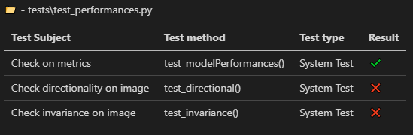
Testing Model Evaluations -Description
In this phase of testing we are checking that our model is behaving correctly.

Slide 17
Testing Model Evaluations-Description
test_ modelPerformances(): this test assure us that the accuracy is greater than 0.50 and f1-score is greater than 0.30.
These values are chosen only for didactic purpose since the training is made using one epoch in order to make it affordable in local devices.
In a production context the thresholds must change according to the requirements.
def test_modelPerformances():
model_ = Model()
data = Dataset()
testSet = data.getTestSet()
# load the best model
loaded_model = model_.loadModel(os.path.join("models", "saved-model"))
# Compile model
loaded_model.compile(
optimizer=tf.keras.optimizers.SGD(
learning_rate=model_.params.learning_rate, momentum=model_.params.momentum
),
loss=tf.keras.losses.CategoricalCrossentropy(
from_logits=False, label_smoothing=model_.params.label_smoothing
),
metrics=["accuracy"],
)
# get labels
predictions_ = np.array([])
labels_ = np.array([])
for x, y in testSet:
predictions_ = np.concatenate(
[predictions_, np.argmax(loaded_model.predict(x), axis=-1)]
)
labels_ = np.concatenate([labels_, np.argmax(y.numpy(), axis=-1)])
print(predictions_, labels_)
# get scores
precision, recall, fscore, support = score(labels_, predictions_, average="macro")
evals = loaded_model.predict(testSet)
assert fscore > 0.3
assert evals[1] >= 0.5

Slide 18
Testing Model Evaluations-Description
test_directional(): The goal of this system-test is to check that to two semantically different inputs corresponds two different predictions.
# directional test
# 2 immagini diverse 2 ouput diversi
def test_directional():
model_ = Model()
data = Dataset()
testSet = data.getTestSet()
# load the best model
loaded_model = model_.loadModel(os.path.join("models", "saved-model"))
output = []
label = -1
# load two images of different classes from testSet
for x, y in testSet:
if label != np.argmax(y.numpy(), axis=-1):
label = np.argmax(y.numpy(), axis=-1)
prediction = loaded_model.predict(x)
print(label, prediction)
output.append(prediction)
if len(output) == 2:
break
print(output[0], output[1])
assert np.argmax(output[0]) != np.argmax(output[1])

Slide 19
Testing Model Evaluations-Description
def test_invariance():
model_ = Model()
data = Dataset()
testSet = data.getTestSet()
# Load the model
loaded_model = model_.loadModel(os.path.join("models", "saved-model"))
example = list(testSet.as_numpy_iterator())
# Extract the image
image_matrix = np.squeeze(example[0][0])
# Extract label from original image
image_label = example[0][1] image_label = np.argmax(image_label[0]) img = np.array(image_matrix, dtype=np.uint8)
# Add noise to original image and verify the classification is correct
img_flipx = cv2.flip(img, 1) img_flipy = cv2.flip(img, -1) img_gauss = cv2.GaussianBlur(img, (9, 9), 0)
# Add an axis to images
img_gauss = img_gauss[np.newaxis, ...]
img_flipy = img_flipy[np.newaxis, ...]
img_flipx = img_flipx[np.newaxis, ...]
gauss_pred = np.argmax(loaded_model.predict(img_gauss))
flipy_pred = np.argmax(loaded_model.predict(img_flipy))
flipx_pred = np.argmax(loaded_model.predict(img_flipx))
assert gauss_pred == flipx_pred == flipy_pred == image_label
test_ invariance(): This test is made getting an image and applying three different transformation:
Flipping
-1
+1
GaussianBlur
The goal is to check that, despite the transfromations, the classification must return same predictions since the transformed images are semantically equivalent.

Slide 20
Testing Model Evaluations-Description
def test_invariance():
model_ = Model()
data = Dataset()
testSet = data.getTestSet()
# Load the model
loaded_model = model_.loadModel(os.path.join("models", "saved-model"))
example = list(testSet.as_numpy_iterator())
# Extract the image
image_matrix = np.squeeze(example[0][0])
# Extract label from original image
image_label = example[0][1] image_label = np.argmax(image_label[0]) img = np.array(image_matrix, dtype=np.uint8)
# Add noise to original image and verify the classification is correct
img_flipx = cv2.flip(img, 1) img_flipy = cv2.flip(img, -1) img_gauss = cv2.GaussianBlur(img, (9, 9), 0)
# Add an axis to images
img_gauss = img_gauss[np.newaxis, ...]
img_flipy = img_flipy[np.newaxis, ...]
img_flipx = img_flipx[np.newaxis, ...]
gauss_pred = np.argmax(loaded_model.predict(img_gauss))
flipy_pred = np.argmax(loaded_model.predict(img_flipy))
flipx_pred = np.argmax(loaded_model.predict(img_flipx))
assert gauss_pred == flipx_pred == flipy_pred == image_label
test_ invariance(): This test is made getting an image and applying three different transformation:
Flipping
-1
+1
GaussianBlur
The goal is to check that, despite the transfromations, the classification must return same predictions since the transformed images are semantically equivalent.

Slide 21
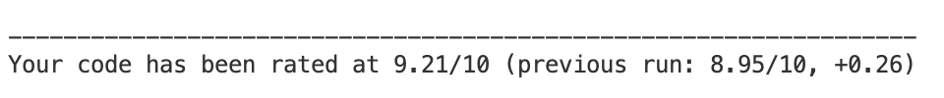
Code analysis with Pylint
src/models: as first result of analysis on the folder we obtained a score of 5.56/10.0 and we reached a score of 8.57/10.0 on the entire folder.
src/data: as first result of analysis on the folder we obtained a score of 7.84/10.0 and we reached a score of 10.0/10.0 on the entire folder.
src/tests: as first result of analysis on the folder we obtained a score of 8.95/10.0 and we reached a score of 9.21/10.0 on the entire folder.

